Slide 1
ENGL2A10 Group Presentation
Group 6
23086489d Lai Ka King Frankie
22101071d Zhu Jin Shun Kingston
22100493d Liu Yuyang Daniel
Notes:
https://youtu.be/8sgLgKUHjZI?si=_xOmPgCLxpHgHc-9

Slide 2
Table of contents
01
02
03
04
Video Viewing
Problem Identifying
Identifying problems on verbal/non-verbal communication etc.
Analysis the Problem
Explain why the problems are unhelpful and unappropiate with research
Suggestion and Improvement
Giving out helpful, effective solutions based on research

Slide 3

0% AI
No AI is used in our presentation

Slide 4
01
Video Viewing

Slide 5
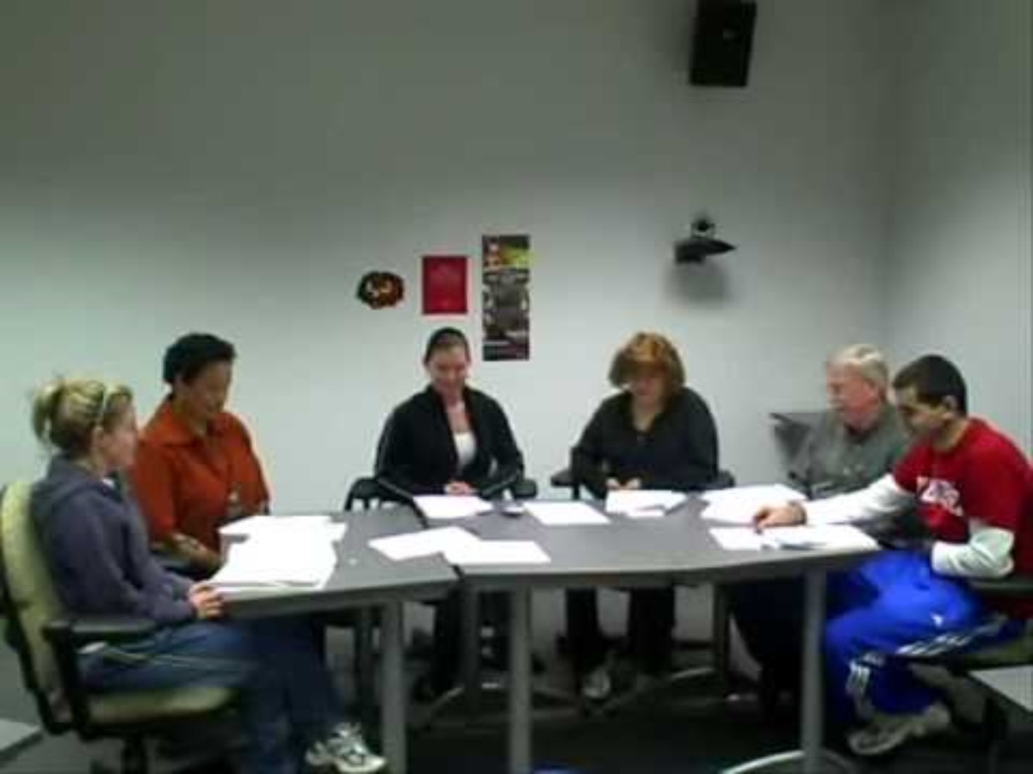

Slide 6
02
Problem Identifying

Slide 7
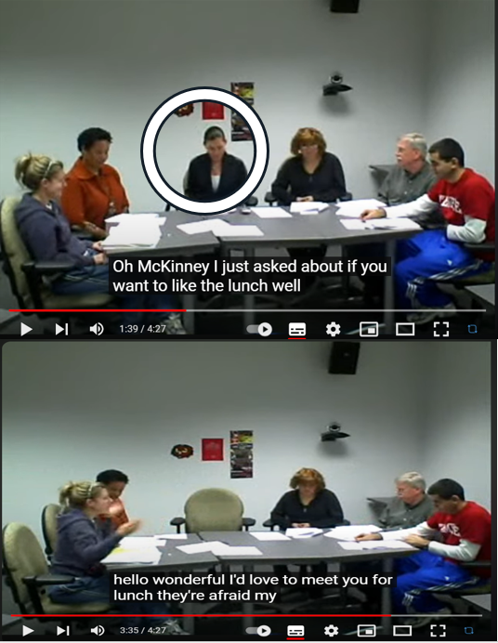
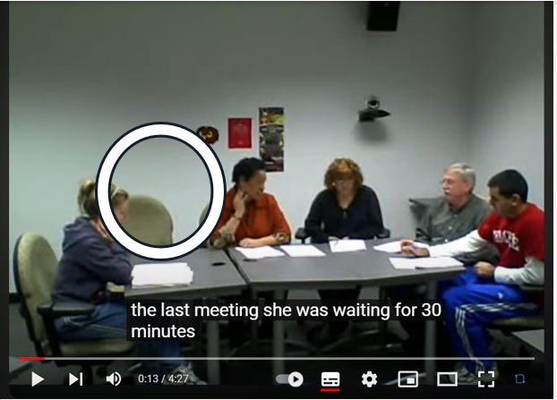
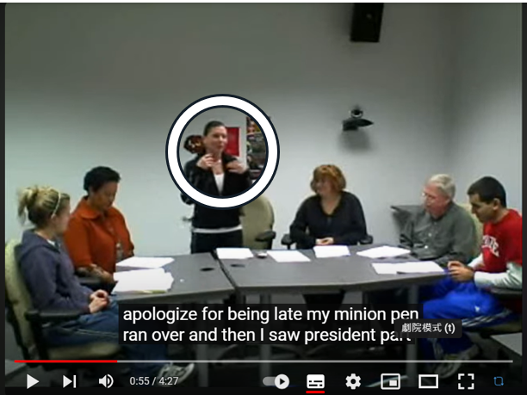
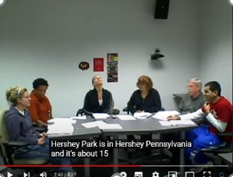
Bad Impression
Being late
(non-verbal)
Making excuses
(poor management)
Being inattentive
(non-verbal)
Lacking of integrity
(poor management)

Slide 8
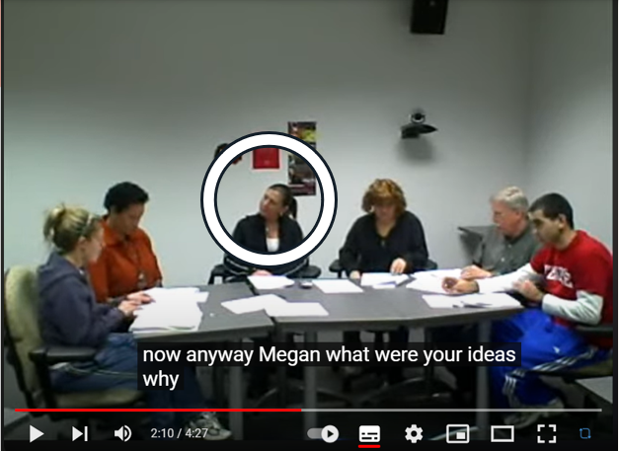
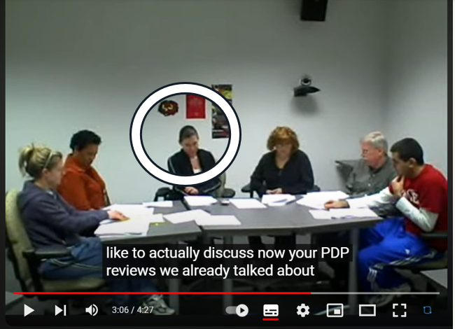
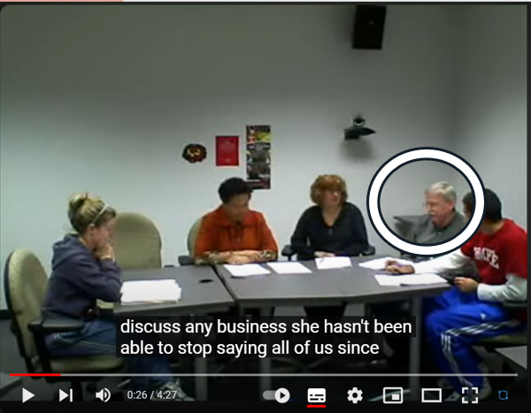
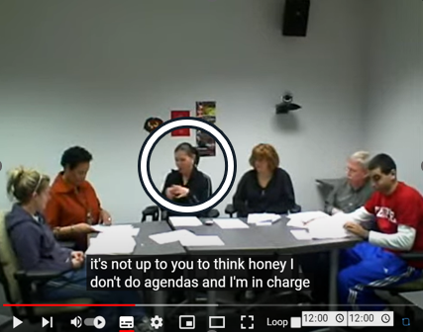
Distraction
Interrupting
(verbal)
Feedback
Complaining
(verbal)
Opposing
(verbal)

Slide 9
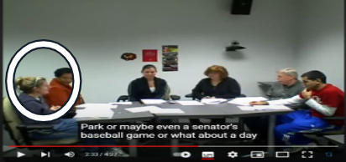
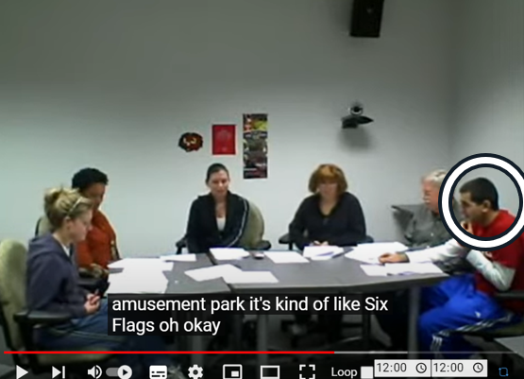
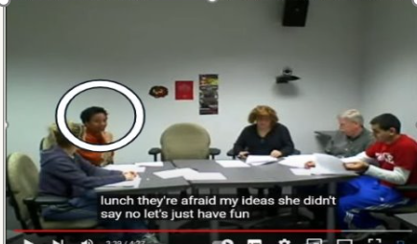
Presentation
Nervous
(verbal)
(non-verbal)
Grouping
Being not united
(poor management)
Being afraid to speak freely
(poor management)

Slide 10
03
Analysis the Problem
Notes:
3:23

Slide 11
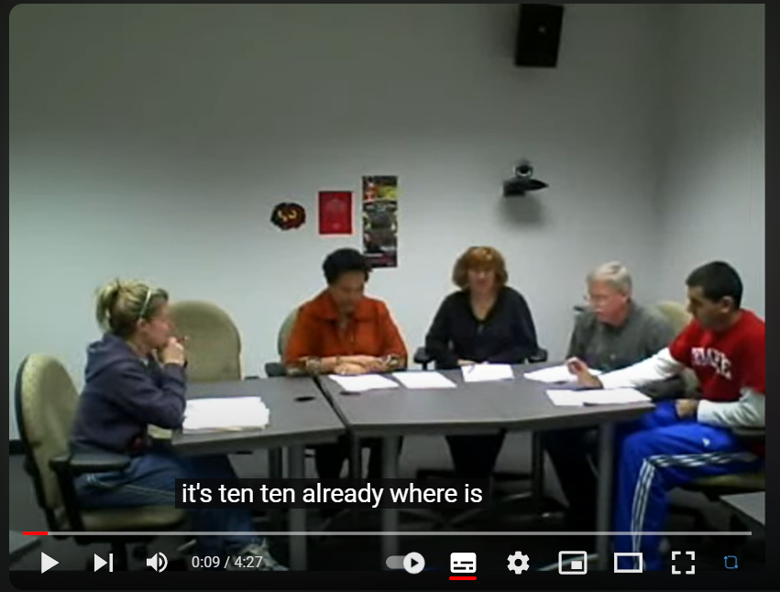
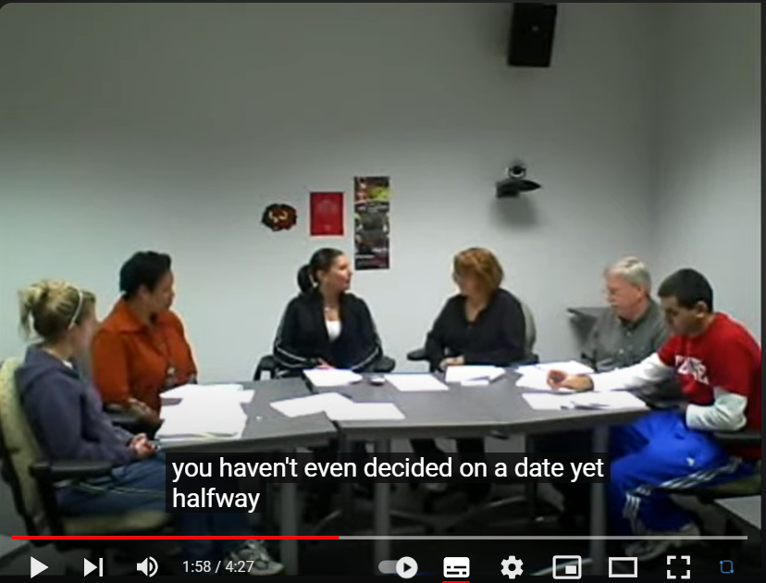
Being Late
Team agreed meeting time
The person came late with not noticing.
Inappropriate behavior
Being late on meetings
=> Significantly lower the meeting satisfaction and effectiveness (Allen, 2018).
Notes:
because the person is not responsible to the team and wasting the time of the group.

Slide 12
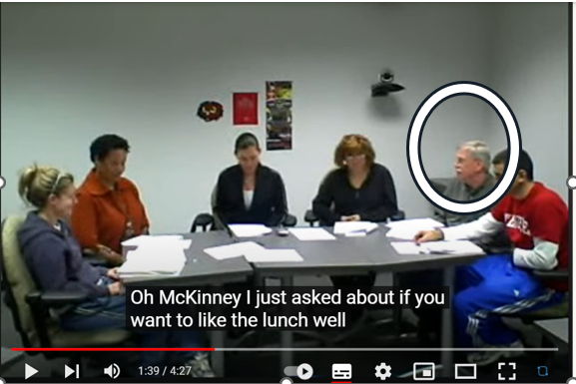
Distracting
/
Interrupting
The people has been distracting the group
Ex: Like her Mexico trip last time, asking if someone would like to have lunch
Inappropriate and negative behavior
Distraction
=> Very significant effect on the task-relevance performance (Hagen, 1967)
Notes:
because it wastes time of the whole team and drags others attention towards something unrelated.

Slide 13
Lack of integrity
Team has already agreed on a lunch break.
The person still broke the promise with no reason and started making excuses.
Harmful to the group
Lack of trustfulness
=> Reducing the desire for teams to communicate and share ideas
=> Leading to reduced collaboration efficiency (Schweitzer, 2006)
Notes:
lack of trustfulness and the group won’t be able to work towards a common goal.

Slide 14
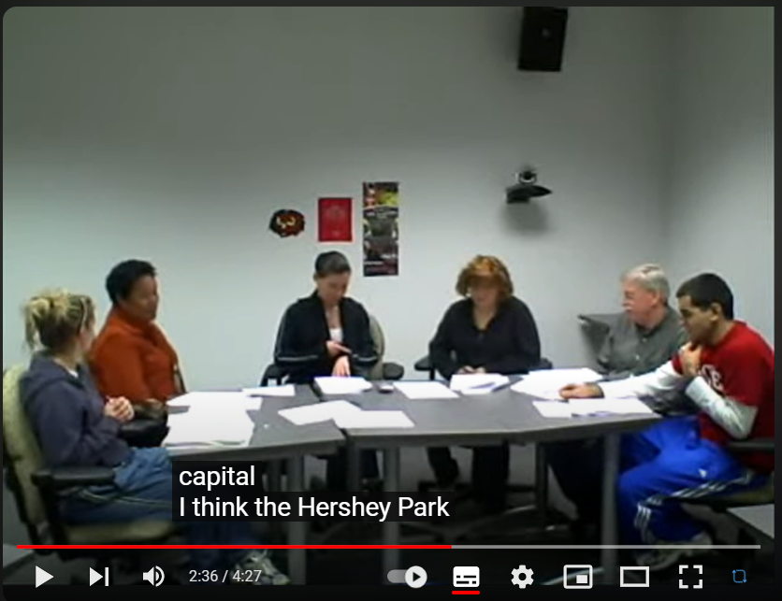
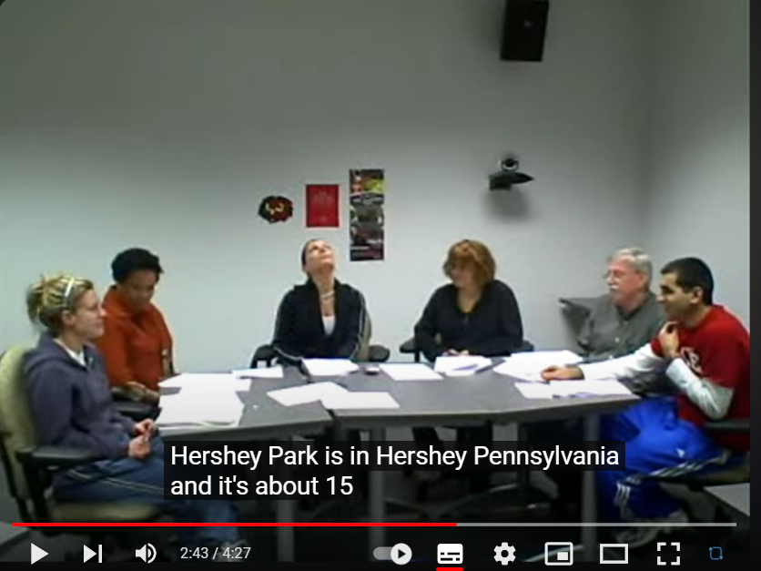
The person have not been paying attention on speakers
Ex: Looking the ceiling, checking the time, forgetting discussion information
An inappropriate behavior
Lack of attentions
=> Missed information, miscommunication, and hindered productivity
=> Leading to delayed decision-making and poor collaboration (Kabat-Zinn, 2015)
Being Inattentive
Notes:
because the person is not obviously not listening to others, it is shows no respect on the person who is speaking. Also, the actions shows that she doesn’t even care about the group discussion.

Slide 15
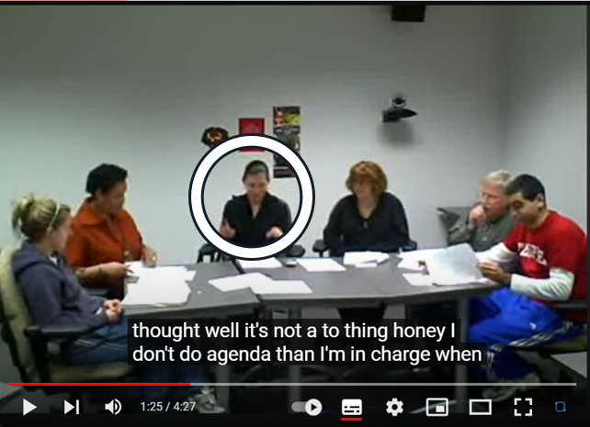
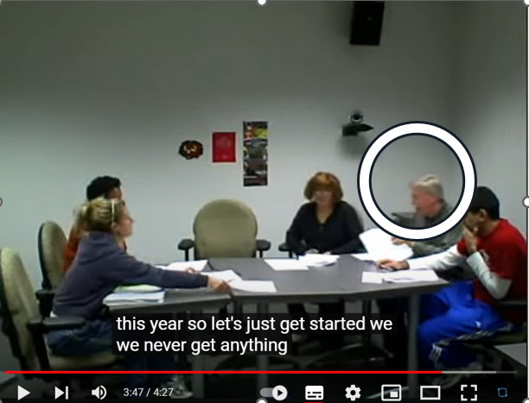
Complaining and opposing occurred.
Ex: Person opposing the use of agenda without proper reason, opposing the date of event without further discussion
Dangerous to the group
Complaining during meetings
=> Create a negative atmosphere, reduce team morale, and hinder constructive discussions
=> Result in decreased productivity and potentially damaging working relationships (Kowalski, 2003).
Complaining
/
Opposing
Notes:
This is harmful to the group as the person didn’t realize that it is not polite, it will hurt others feeling and leads attention to other directions in the team.

Slide 16
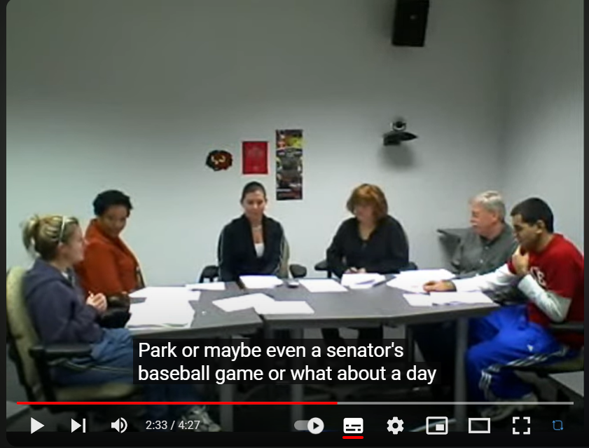
Being Nervous
The person in the picture has actions that shown she is nervous
Ex: Rubbing her hands during speaking
Relationship
Being nervous during meetings
=> Hinder effective communication and decision-making, potentially
=> Lead to missed opportunities and decreased productivity. (Neel, 1995)
Notes:
Being nervous shows that she might not be confident for what she will be talking about. She might be not certain about what she wants to say or if the thing she is going to say is appropriate or not.

Slide 17
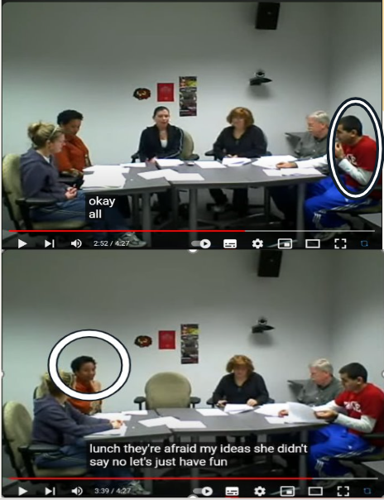
Grouping
Grouping problem has occurred during the whole meeting
Ex: Fear to ask questions, complaining, opposing
Poor management
Tuckman's stages
=> Disunited groups may experience decreased productivity and difficulty in achieving their goals
=> Due to a lack of cohesion and collaboration. (Tuckman, 1965)
Notes:
During the meeting, the whole group was showing that they are not united, they have been opposing and complaining about each other, and some member don’t pay attention on others when speaking. For questions about the group members, they also aren’t willing or not confident enough to ask out.

Slide 18
04
Suggestion and Improvement

Slide 19
Being Late
1. Time Management: Plan Ahead
2. Use of Technology:
Reminders
Time Tracking Apps : e.g. Toggl, RescueTime, HourStack...
3. Behavioral Changes:
Building sensible routing (Duhigg, 2012).
Notes:
1.Schedule the meeting in your calendar with a 15-minute buffer time to handle unexpected delays.
2.Set multiple reminders using apps like Google Calendar or Outlook.
3.Utilize time tracking apps such as Toggl or RescueTime to assess how you spend your time
4.Establish a routine that includes checking your schedule every morning and evening

Slide 20
Distracting/Interrupting
1. Establish Ground Rules:
Encourage participants not to be multitask at once (Levitin, 2014).
Silence Phones
2. Effective Meeting Structure:
Clear Agenda for whole meeting (Rogelberg, 2019).
Set up the Time Limits
3. Engagement Strategies:
Encourage Active Participation
Breakout Sessions
Notes:
2.Mobile phones are a huge distraction for people these days. Ask participants to put their phones on silent mode to minimize interruptions.
3.Send out a precise agenda ahead of time so participants can prepare and stay on topic
4.Too long of a meeting can leave attendees drowsy and unfocused. Set and adhere to time limits for each topic and the overall meeting to maintain focus.
5.Involve attendees in the discussion by asking for their input regularly
6.For larger meetings, use breakout sessions to keep discussions relevant for all participants.

Slide 21
Lack of integrity
1. Develop a Code for the whole meeting(Kidder, 2009).
2. Enforcement of accountability in the meeting process(Brown, 2018)
3.Meeting organisers or leaders should lead by example and set a role model for participants.
Notes:
1. Establish a code of conduct that includes expectations for integrity during meetings and consequences for not adhering to it.
2.Ensure that all team members, including management, are held accountable for their actions during meetings. Works well with the first point

Slide 22
Complaining/Opposing
1.Active listening to participants helps to reduce complaints (Grenny et al., 2013).
2.Topic openers can redirect the conversation while reasonably asking the complainant why they are complaining (Zenger & Folkman, 2009).
3.Use the "Yes, and..." Technique (Coyle, 2018).
Notes:
1.Often, individuals who frequently complain may feel unheard. Ensure that everyone's opinions are listened to and acknowledged, which can help reduce oppositional behavior
2.When a participant starts to complain or oppose without basis, gently steer them back to the topic at hand, and ask for concrete evidence or rationale behind their stance
3.This technique from improvisational comedy encourages adding to the conversation ("Yes, and...") instead of shutting others down ("No, but...") , for example we can say like "yes your thought is good , and I think" to stop them complaining.

Slide 23
Being Inattentive
1. Incorporating interactive elements into a meeting allows participants to better focus on the content.(Coyle, 2018).
2.Use Visual Aids can help attendees understand the content of the meeting. (Mayer, 2009).
Notes:
Use interactive strategies like polls, breakout sessions, and Q&A segments to keep participants engaged (Coyle, 2018).
Incorporate slides, charts, and other visual aids to supplement verbal communication and retain attention

Slide 24
Being Nervous
1.Practice and preparation by participants (speakers) in advance of the meeting can be effective in reducing stress.
2.Participants (speakers) can use breathing techniques to reduce stress (Harris, 2019).
Notes:
Encourage speakers to practice their parts before the meeting. Rehearsal can reduce anxiety by increasing familiarity with the material

Slide 25
Grouping
1. Setting a clear and common purpose for the meeting
2.Encouraging open communication in a team helps with team management (Edmondson, 1999).
3.Clarifying Roles and Responsibilities can significantly reduce the problem of overlapping workloads among participants and reduce conflicts. (Katzenbach & Smith, 1993).
Notes:
Clearly articulate the purpose and objectives of the meeting in advance to ensure that all participants understand the common objectives
It allowing every member to express their thoughts and concerns without judgment

Slide 26

References
Allen, J. A., Lehmann‐Willenbrock, N., & Rogelberg, S. G. (2018). Let's get this meeting started: Meeting lateness and actual meeting outcomes. Journal of Organizational Behavior, 39(8), 1008-1021.
Hagen, J. W. (1967). The effect of distraction on selective attention. Child development, 685-694.
Schweitzer, M. E., Hershey, J. C., & Bradlow, E. T. (2006). Promises and lies: Restoring violated trust. Organizational behavior and human decision processes, 101(1), 1-19.
Kowalski, R. M. (2003). Complaining, teasing, and other annoying behaviors. Yale University Press.
Kabat-Zinn, J. (2015). Why paying attention is so supremely important. Mindfulness, 6(6), 1484-1486.
Katzenbach, J. R., & Smith, D. K. (1993). The wisdom of teams: Creating the high-performance organization. Harvard Business School Press.

Slide 27
References
Duhigg, C. (2012). The power of habit: Why we do what we do in life and business. Random House.
Levitin, D. J. (2014). The organized mind: Thinking straight in the age of information overload. Dutton.
Rogelberg, S. G. (2018). The surprising science of meetings: How you can lead your team to peak performance. Oxford University Press, USA.
Kidder, R. M. (2009). How good people make tough choices: Resolving the dilemmas of ethical living. Harper.
Brown, B. (2018). Dare to lead: Brave work. Tough conversations. Whole hearts. Random House.
Harris, R. (2019). The confidence gap: A guide to overcoming fear and self-doubt. Trumpeter.
Edmondson, A. C. (1999). Psychological safety and learning behavior in work teams. Administrative Science Quarterly, 44(2), 350-383.

Slide 28
References
[PhAdY]. (2009, April 2). Ineffective Meeting [Video]. YouTube. https://youtu.be/8sgLgKUHjZI?si=_xOmPgCLxpHgHc-9
Neel, R. G. (1955). Nervous stress in the industrial situation. Personnel Psychology.
Tuckman, B. W. (1965). Developmental sequence in small groups. Psychological bulletin, 63(6), 384.
Grenny, J., McMillan, R., & Switzler, A. (2013). Crucial conversations: Tools for talking when stakes are high. McGraw-Hill Education.
Zenger, J. H., & Folkman, J. (2009). The extraordinary leader: Turning good managers into great leaders. (No Title).
Coyle, D. (2018). The culture code: The secrets of highly successful groups. Bantam Books.
Mayer, R. E. (2009). Multimedia learning (2nd ed.). Cambridge University Press.

Slide 29
Thanks!
Wish Everyone have GOOD meetings ☺
Next will be Q&A sessions

